Slide 1

United Curriculum
Primary Science

Slide 2
Principles of the Science Curriculum
The United Curriculum for science provides all pupils, regardless of their background, with:
Substantive knowledge:
Ensuring pupils master core content through the development of key concepts and timely revisiting of key knowledge
Sequencing the curriculum and selecting knowledge to allow for gradual development of vertical concepts – the ‘big ideas’ in science – to provide firm foundations for KS3 and KS4
Preventing common misconceptions that are often formed at an early age and prove problematic at the later stages of pupils’ science education
Purposefully teaching appropriate knowledge that goes beyond the KS1 and KS2 national curriculum, to aid current and future understanding, and to smooth the transition to KS3
Encouraging pupils to apply and make connections between the disciplines of science, the wider curriculum and the wider world
Disciplinary knowledge:
Sequencing Working Scientifically elements so that they are explicitly taught and practised alongside the substantive knowledge, and regularly reviewed and built upon across the years and key stages
Making deliberate and explicit links to other curriculum areas – particularly geography and mathematics – to ensure there is a consistent approach to teaching content, and that pupils are always first taught content in the most relevant subject. For example, pupils are taught how to construct bar charts or calculate the mean in mathematics before they are applied in science
Planning practical tasks that have a clear purpose: to demonstrate or prove substantive concepts, or to allow pupils to deliberately practice working scientifically skills in a relevant context
Curiosity and excitement about science:
Selecting examples and applications of science that inspires pupils’ curiosity about the world and natural phenomena
Ensuring that all pupils can see themselves reflected in the science curriculum, by highlighting present-day role models and the contributions of scientists from a wide range of backgrounds; and considering social and cultural values around scientific ideas

Slide 3
United Curriculum: Science
Biology
Classifying
Organisms
Physics
Light
Biology
Animals
Chemistry
Everyday
Materials
Biology
Humans
Year
4
Biology
Food & Digestion
Biology
Evolution
Biology
Further Classification
N 3/4
Biology / Physics
Seasonal Changes
Year 2
Physics
Magnetism
Chemistry
Particle Model
Physics
Electricity
Biology
The Human
Body
It’s Getting Cold Outside / Bears
Biology
Plants
Biology
Plant Growth
Physics
Forces
& Motion
Physics
Sounds
Year 6
Chemistry
Physical & Chemical Changes
Polar Express & Special Days
Year 1
Biology
Needs of Animals
Biology
Plants
Physics
Electricity
Physics
Earth & Space
Key Stage 3
On the Move / Toys
Science Detectives
Chemistry
Uses of Materials
Biology
Organisms
Chemistry
Properties of Materials
Physics
Forces
On the Farm / Glorious Food
Me and My World
Biology
Living Things & Habitats
Physics
Light
Year 5
Biology
Human Development
Once Upon a Time
1/2
Chemistry
Solids, Liquids & Gases
Chemistry
Rocks
Chemistry
Separating Mixtures
Biology
Life
Cycles
All Creatures Great & Small
1/2
R
Year
3
Physics
Energy

Slide 4
United Curriculum: Science
 | N3-4 | Reception | Year 1 | Year 2 | Year 3 | Year 4 | Year 5 | Year 6
Autumn 1 | It’s getting cold outside / Bears Weather where we live, habitats where bears live |  | BIOLOGY Plants Identifying and naming common plants and describing basic structures | BIOLOGY Plant growth Plants grow from seeds, and require water, light and a suitable temperature | CHEMISTRY Rocks Comparisons of types of rocks and how fossils are formed | BIOLOGY Classifying organisms Introduction to classifying animals and their environment | CHEMISTRY Separating mixtures Identifying and separating mixtures; reversible and non-reversible changes | PHYSICS Electricity Investigating variations in series and parallel circuits, and how electricity is generated
Autumn 2 | Polar express / Special days Melting and freezing; natural and artificial materials |  | BIOLOGY / PHYSICS Seasonal changes Observing changes across four seasons and describing associated weather | BIOLOGY Needs of animals Animals need water, food and air to survive and to have offspring | PHYSICS Light Relationship between light and how we see; the formation of shadows | BIOLOGY Food & digestion The human digestive system and food relationships in ecosystems | BIO / CHEM / PHYSICS Energy Introducing the concept of energy stores and energy transfers; relate this to prior knowledge | BIOLOGY Evolution Fossils; introduction to the idea that adaptation may lead to evolution
Spring 1 | On the Move / Toys Exploring pushes, pulls and magnets |  | CHEMISTRY Everyday materials Distinguishing objects from their material, and describing simple properties | CHEMISTRY Uses of materials Comparisons of an object’s material with its use; impact of bending, twisting on solid objects | BIOLOGY Organisms The role of muscles and skeletons; the importance of nutrients | CHEMISTRY Particle model and states of matter States of matter in relation to particle arrangement | BIOLOGY Life cycles Life cycles of a mammal, amphibian, insect, bird, and some reproduction processes | PHYSICS Light How light travels and is reflected, and how this allows us to see
Spring 2 | On the Farm / Food Glorious Food Life cycles of farm animals and plants | Spring in our step Wildlife and weather in spring and winter; habitats around our school | Consolidation and review | BIOLOGY Living things & habitats Introduction to habitats, micro-habitats, and simple food chains | BIOLOGY Plants Features of flowering plants and what they need to survive | PHYSICS Sounds Relationship between strength of vibrations and volume of sound | BIOLOGY Human development Human development to old age | BIOLOGY Further classification Further classification of organisms based on characteristics
Summer 1 | Once upon a time 1 / 2 Properties of materials and exploring mixtures |  | BIOLOGY Animals Naming reptiles, fish, amphibians, birds and mammals; carnivores, herbivores, omnivores | CHEMISTRY Solids, liquids and gases How the same substances can exist as solids, liquids and gases | PHYSICS Forces & motion Introducing pushes and pulls; opposing forces, and balanced forces | PHYSICS Electricity Simple series circuits | PHYSICS Forces Gravity, air and water resistance and friction; introduction to pulleys | BIOLOGY Functions of the human body Human circulatory system; transport of nutrients within the body
Summer 2 | All creatures great and small 1 / 2 Life cycles of animals in trop. rainforests, sea, and grasslands | Science detectives Properties of materials and habitats around the world | BIOLOGY Humans Human body parts and senses | Consolidation and review | PHYSICS Magnetism Contact and non-contact forces, including friction and magnetism | CHEMISTRY Properties of materials Considering physical and chemical properties | PHYSICS Earth and space Movements of planets and the Moon, and relationship to day and night | CHEMISTRY Physical and chemical changes Identifying physical and chemical changes

Slide 5
Science in our Local Context
Science is taught in 6-lesson units, two a term. Science is taught for two hours each week.
The United Curriculum is sequenced so that meaningful links are made between subjects, and the order of units allows these connections to be made.
The United Curriculum for Science has been adapted for Marlborough Road Academy by considering the context of our pupils and the community.
For example:
Pupils learn about habitats, ecosystems, species (both plant and animal) and nature reserves that are found in our local area. This is incorporated into all units where the natural world is studied to include Y1: Plants, Year 1: Animals, Year 2: Living things and their habitats, Year 3: Plants, Year 4: Classifying organisms, and Year 6: Further classification.
Pupils learn about materials that are sourced in our local area and industries that make products from these materials locally in Year 1: Everyday materials, to make objects and Year 2: Uses of everyday materials.
Pupils look at pictures of local rock formations, rock types and fossils found locally in Year 3: Rocks.
Pupils learn about local sustainability initiatives such as recycling facilities in Year 2: Everyday materials and examples of renewable energy found locally in Year 6: Electricity.
Pupils learn about industries and products made in the local area, this is taught in the units where it is most relevant Pupils learn about extreme weather observed in our local area in Year 1: Seasonal changes.
Pupils learn about foods that are grown in the local area in Year 2: Plant Growth
Pupils learn about research conducted by scientists working in universities or specialist laboratories in the local area Pupils learn about local scientists and their work, both past and present

Slide 6

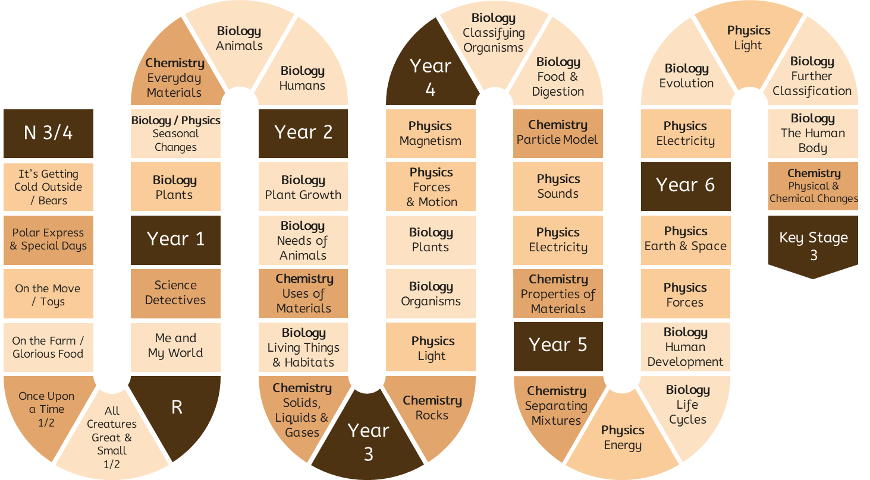
Progression in Vertical Concepts
Chemistry
1.
All material in the universe is made of very small particles.
If a material could be divided into smaller and smaller pieces, it would be found to be made of particles, which smaller than can be seen even with a microscope. These particles are not in a material; they are the material.
The particles of a substance are arranged differently when it is solid, liquid or gas.
Objects have a purpose and are made of different materials.
Properties of materials can be physical (such as hardness) or chemical (such as toxicity).
The same thing (water) can look different when it is hot or cold (ice).
A chemical change is where a new substance – that is made of a different type of particle – is formed.
The smallest piece of a material is called an atom. All materials, anywhere in the universe, living and non-­‐living, are made of a very large numbers of these basic ‘building blocks’, of which there are about 100 different kinds.
All the ‘stuff’ encountered in everyday life, including air, water and different kinds of solid substances, is called matter.
Different materials are recognisable by their properties.
Materials have different properties, which make them suitable for specific purposes.
Matter can exist in three different states: as solids, liquids and gases.
The amount and type of substance does not change when the matter changes state.
A pure substance is one that contains only one type of particle.
A mixture is created when two or more substances are mixed. The two types of particle are mixed together, but the particles themselves stay the same.

Slide 7

Progression in Vertical Concepts
Physics
2.
Objects can affect each other at a distance.
3. Forces act in pairs. Forces acting against each other are opposing.
If opposing forces equal, they are balanced, and the object’s motion will stay the same; this includes staying stationary. If opposing forces are unequal, they are unbalanced will change an object’s speed, direction or shape.
Friction is a force that will slow an object down.
2. The non-contact force of magnetism mean magnets can attract or repel other magnets and attract objects made of magnetic materials.
3. Friction is an example of a contact force.
2. Sound comes from objects that vibrate and can be detected at a distance from the source, because the air or other material around is made to vibrate. Sounds are heard when the vibrations in the air reach our ears.
3.
Changing the movement of an object requires a net force to be acting on it.
2. There is attraction and repulsion between objects that are electrically charged. Visible light and other forms of radiation can travel through any empty space.
3. How quickly an object’s motion is changed depends on the force acting and the object’s mass. The greater the mass of the object, the longer it takes to speed it up or slow it down (inertia).
2. Magnets can attract or repel other magnets.
Magnets attract magnetic objects.
3. We can push and pull objects to make them move.
3. The downward force of gravity on an object on the Moon is less than that on Earth because the Moon has less mass on Earth.
2. The non-contact force of gravity pulls objects towards the centre of the Earth.
3. There is gravitational force between all objects, but it is only felt when one or more of the objects has a very large mass. The greater the mass, the greater the gravitational force.
Objects on Earth are pulled to the centre of the Earth because the Earth’s mass and therefore gravitational force is much larger than that of the objects.
3. We can move or change the shape of objects by pushing and pulling: by squashing, bending, twisting or stretching the materials.
2. Objects can affect other objects even when they are not in contact with them. Light reaches our eyes, even though the light source may be far away.

Slide 8
Progression in Vertical Concepts
Physics
4.
The total amount of energy in the Universe is always the same, but energy can be transformed when things change or are made to happen.
4. In most plants, sunlight, carbon dioxide and water are used to make food in the leaves.
4. The arrows in a food web show where energy is being transferred from and to.
4. Energy resources can be renewable (such as wind, solar, geothermal and hydrological) or non-renewable (such as fossil fuels).
6. Daytime is when the Earth is facing the Sun; nighttime is when the Earth is facing away from the Sun.
4. All organisms respire.
4. Objects have energy because of their chemical composition, their movement, their temperature, their position in a gravitational or other field, or because of compression or distortion of an elastic material.
6. The tilt of the Earth’s axis gives rise to seasons.
The movements of galaxies suggest that the Universe is expanding from a past state called the ‘big bang’, towards a future that is still unclear.
6.
Our solar system is a very small part of one of millions of galaxies in our universe.
4. We have to push or pull objects to make them move; they do not move on their own.
6. Naming the Sun, Earth and Moon.
6. Our Sun is one of many stars that make up the Universe.
The distances between us and the bodies in solar system is huge, and even bigger in the Universe.
4. All living things need food to give them energy (and other things).
All food chains start with a producer (a living thing that makes its own food).
The arrows in a food chain show where energy is being transferred from and to.
6. The Sun emits light, some of which reaches Earth. The Moon reflects light from the Sun.
4. A cell in a complete circuit can make a bulb light or buzzer sound. This will not happen without a cell.
4. Many processes and phenomena are explained in terms of energy exchanges.
Energy cannot be created or destroyed. When energy is transferred from one object to others, the total amount of energy in the universe remains the same; the amount that one object loses is the same as the other objects gain.
Two examples of energy stores are thermal stores and chemical stores of energy.
Energy resources – but not energy – can be depleted.

Slide 9

Progression in Vertical Concepts
Earth Science & Geology
5 (A)
The composition of the Earth and its atmosphere and the processes occurring within them shape the Earth’s surface and its climate.
Geography: Features of hot deserts include rocks, sand dunes and oases. Features of cold deserts include mountains and ice sheets.
Rivers travel from highland areas to lowland areas. Physical features around rivers include valleys, mountains, hills and vegetation.
Geography: Use of fossil fuels to create plastics, and the effects this can have on the Earth.
Some plants grow in soil.
Geography: Formation of volcanoes and mountains at different types of plate boundaries. Movement of tectonic plates as caused by convection currents.
Radioactive decay of material inside the Earth since it was formed is its internal source of energy. Understanding the use of Earth’s energy resources in terms of energy stores and transfers.
Describing the natural things in our local area.
Geography: We live on the Earth. Physical features occur in nature and include river, forest, soil and hill.
Coastal areas are areas of land that are near the sea. Features in coastal areas include beach, cliff, sea and ocean.
Geography: Examples of natural resources include wood, food, water and fossil fuels. Fossil fuels are materials made from fossils over millions of years, like coal and oil. Humans use these to run cars and electrical items.
Natural resources are unevenly distributed across the world and can be renewable or non-renewable (finite).
The upper course of a river is in high, mountains ground and the river is narrow and fast flowing. The lower course of a river is in low, flat ground and the river is wide and slow flowing. The middle course is between the two. Rivers erode, transport and deposit to form waterfalls, meanders and floodplains.
Geographical features include beach, hill, forest, sea and river.
Rocks are formed when placed under pressure.
Much of the solid surface of the Earth is covered in soil, which is a mixture of pieces of rock of various sizes and the remains of organisms. Some soil also contains air, water and some nutrients.
There are three main kinds of rock: igneous, sedimentary and metamorphic, which each have different composition and properties.
Geography: There are several mountain ranges in the UK.
The Earth has four layers. Its upper layer of tectonic plates move.
Shield and composite volcanoes can form at plate boundaries, which produce lava, pyroclastic flows and lahars.
Soil is rich with nutrients around volcanoes.

Slide 10
Progression in Vertical Concepts
Environmental Science
Geography: The layer of air around the Earth is called the atmosphere.
Atmospheric circulation causes some areas on Earth to have higher levels of precipitation than others.
Tropical rainforests are places where there is lots of precipitation.
5 (B)
The composition of the Earth and its atmosphere and the processes occurring within them shape the Earth’s surface and its climate.
Geography: The weather is short-term. Climate is long-term summary of the weather conditions.
Precipitation is the fall of water as rain, sleet, snow or hail.
Deserts are places where there is very little precipitation.
The water cycle involves evaporation of water from oceans and condensation of water, which falls as precipitation.
The weather can change rapidly. The four different seasons have different weather patterns.
Geography: Mitigation and adaptation are ways that humans can reduce and live with the effects of climate change.
Types of weather include sunny, rainy, windy, and snowy.
Geography: Weather is determined by conditions of the air. The pressure, temperature, direction and speed of the movement and the amount of water vapour in the air combine to create weather.
Understanding convection currents in terms of pressure and particles.
The air is all around us on Earth. Air has oxygen in it.
We experience different types of weather in different seasons (focus on spring and winter).
There is less and less air further away from the Earth’s surface; space is a vacuum.
Global warming describes the increase in Earth’s average temperatures.
Air has carbon dioxide in it.
Air is a mixture of lots of different gases, including oxygen and carbon dioxide.
Geography: The amount of water on Earth is constant. Most is saltwater stored in oceans, and most freshwater is stored as ice or underground.
Water cycle: Evaporation from the air and transpiration from plants means that water vapour rises in the air. It condenses to form clouds and precipitation occurs when the clouds get heavy. Surface runoff is the flow of water overground; throughflow is the flow of water underground.
Climate zones share long-term weather patterns. There are six main climate zones: polar, temperate, arid, tropical, Mediterranean and mountains.
Biomes are areas of the world that, because of similar climates, have similar landscapes, flora and fauna. The major biomes of the world are tundra, tropical rainforests, coral reefs, temperate forests and hot deserts.
The natural greenhouse effect, the enhanced greenhouse effect, global warming and resulting climate change.
The increase in frequency of extreme weather events like heatwaves and drought as a result of climate change.

Slide 11

Progression in Vertical Concepts
Biology
7.
Organisms are organised on a cellular basis.
8. Living things, including humans, react to their surroundings with their senses.
8. Plants make their own food using sunlight, carbon dioxide and water.
8. The feeding relationships between organisms can be represented as food chains and food webs. They show where the energy is being transferred from and to.
7. Plants are organised with roots, stem, leaves and flowers.
7. Micro-organisms are organisms that are so small that we cannot see them with our eyes alone.
8. There is a wide variety of living things on Earth, including plants and animals.
8.
Organisms require a supply of energy and materials for which they are often dependent or in competition with other organisms.
7. Respiration takes places in cells.
8. Living things move, reproduce, are sensitive to their surroundings, grow, respire, excrete, and need nutrition (MRS GREN).
8. All living things need food, oxygen, water and certain temperature conditions.
7. All organisms are made of one or more cells, which can only be seen through a microscope. All the basic functions of life – growth, reproduction, extracting energy from food – are the results of what happens inside cells. Cells are often aggregated into tissues, tissues into organs, and organs into organ systems.
8. Decomposers are essential (alongside producers and consumers) for a stable ecosystem.
8. Most plants make their own food. Animals’ food comes from eating plants (herbivores) or by eating animals (carnivores), which have eaten plants or other animals. These relationships can be represented in a food chain.
Plants and animals are often dependent on each other.
Organisms are adapted to their environment. If conditions in a habitat change, organisms may not be able to survive.
Organisms move, reproduce, are sensitive to their surroundings, grow, need oxygen, get rid of their waste, and need nutrition (MRS GOWN).
7. Humans are organised with organs like hearts and lungs, which do particular jobs. The skeleton and muscles allow the body to move.
8. Energy is transferred to the Earth by light. When making their own food, plants transfer some of this energy to their chemical store. As other organisms eat these producers, some energy in this chemical energy store is transferred.
7. A cell is the smallest building block of living things. All organisms are made of cells.
There are lots of different types of cell (e.g. sex cells), which each have different purposes.

Slide 12
Progression in Vertical Concepts
Biology
10. To help scientists make sense of the diversity of organisms, they are classified into different groups. Each group has similar features.
9. When a plant reproduces, it goes through stages of pollination, fertilisation and seed dispersal. The seed will then germinate and grow into a plant.
9. A species is a group of one type of organism. Individuals in this group can breed with each other to produce offspring that can go on to reproduce.
10. Variation exists within species, caused by genetic and environmental factors.
Living things are found in certain environments because they have the features that enable them to survive there. This adaptation to their environment has come about because of the small differences that occur during reproduction, resulting in some individuals being better suited to the environment than others. In the competition for materials and food, those that are better adapted will survive and are more likely to pass on their adapted feature to their offspring. Fossils are evidence of evolution.
9.
Genetic information is passed down from
one generation of organisms to another.
10. There are lots of types of animal, and some types can be grouped as amphibians, birds, fish, mammals and reptiles.
10.
Diversity of organisms, living and extinct, is the result of evolution.
9. Plants and animals reproduce (have offspring).
9. Young animals grow into adult animals. The young look similar, but not the same, as the adults.
9. In a human body, most cells contain 23 pairs of chromosomes. These provide information that is needed to make more cells in growth and reproduction.
10. The natural selection of organisms has been going since the first form of life appeared on Earth 3.5 billion years ago. Multi-cellular organisms evolved around 2 billion years ago.
10. There are many different kinds of plants and animals in the world today.
9. When there are no living individuals of a species to reproduce, the species is extinct.
10. We know about extinct and dead species from fossils. These are the preserved remains (or traces) of organisms that lived many years ago.
9. An organism's genome is the information that controls how that individual organism will develop.
In sexual reproduction, two parents contribute to the formation of offspring. They each pass down half their genome through specialised cells called sex cells. The two halves are combined during fertilisation. While it inherits genetic information from both parents, the offspring's genome is distinct, which means the offspring is not identical to a parent.
Asexual reproduction involves only one parent. In this process, the offspring's genome is an exact copy of the parent's genome. The offspring is identical to the parent.
9. A species is a group of living things of the same type.
10. Biodiversity describes all the different living things in an area.
Living things are adapted to their environments. If the environment changes, the organisms may no longer be adapted and may struggle to survive.

Slide 13
Progression in Vertical Concepts
Biology
11. Visual impairments include long and short sightedness, colour vision deficiency, and blindness. Some of these can be corrected, and some people with visual impairments will use Braille, magnifying devices, canes and/or guide dogs.
11.
Organisms are healthy when physically, mentally and socially well and free from disease.
11. Humans have five senses. Some people have impairments, like visual and hearing impairments.
11. Bacteria are tiny living things. Some are useful for humans, and some can cause diseases. Bacteria can cause tooth decay.
11. Humans with hearing loss may use closed captions, hearing aids and/or sign language.
11. Being healthy means we are in a state of physical, mental and social well being and are free from disease. Some drugs can help us and some can harm us (particularly in the wrong quantities).
11. Humans need to practise good hygiene, like brushing teeth and washing hands.
11. The biological causes and effects of diseases (e.g. coeliac disease and emphysema), exercise, lifestyles (e.g. vaping) and deficiencies on the body. Pathogens, their transmission and how transmission can be prevented.
11. Healthy development includes cognitive, physical, social and emotional development. Most of this happens during infancy and childhood. Ageing happens naturally, and can be sped up by environmental factors like smoking.
Some adults are unable to become pregnant. IVF and other treatments can be used.
11. Humans need to exercise, practise good hygiene and eat a healthy and balanced diet to stay healthy. Their diet should be high in fruits and vegetables and low in fats, sugar and salt.
11. A balanced diet includes the right proportions of the main food groups of carbohydrates (starch and sugars), proteins, fats, fibre, vitamins and minerals.
Animals, including humans, may get diseases (like scurvy) if they are deficient in vitamins and minerals.
11. Some substances are toxic; this means they can be poisonous. Humans and other organisms need to avoid these to stay healthy.

Slide 14
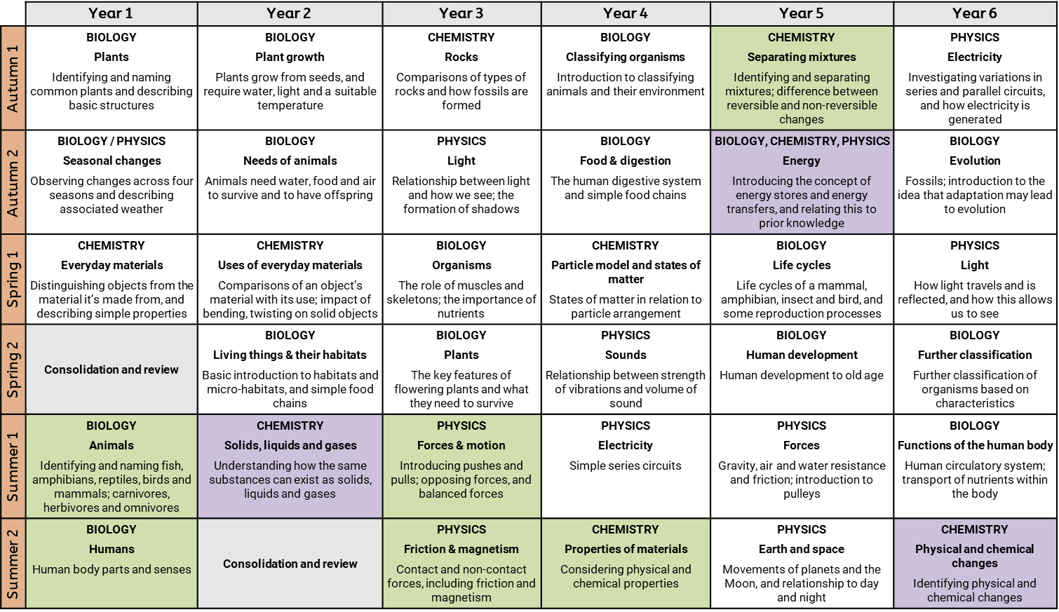
Alignment to the National Curriculum
Substantive knowledge
The units that are not highlighted in colour align directly to the topics in the Programmes of Study and cover – at a minimum – the statutory content set out.
The statutory content in some topics in the Programmes of Study is substantial. Where this is the case, more time has been dedicated to it and the content is split into two complementary units. This allows sufficient time for mastery.
Three additional units purposefully take pupils beyond the Programmes of Study:
Year 2: Solids, liquids and gases. This introduces pupils to the idea that familiar substances (like water or chocolate) can exist as solids, liquids or gases. It will support understanding of states of matter and the particle model in Year 4, and preempts the misconception that substances only ever exist in one state.
Year 5: Energy. This introduces pupils to energy stores and transfers at a very basic level, and has been designed to preempt misconceptions that need to be unpicked at secondary. It also allows pupils to review content from previous topics across biology, chemistry and physics (like food webs, electricity, and states of matter), and consider them through the lens of energy.
Year 6: Physical & chemical changes. This unit gives pupils the opportunity to run more sophisticated practical investigations. It provides a good transition to Year 7.
There are opportunities for pupils to consolidate or review knowledge in KS1, to ensure that these early concepts are fully mastered before KS2. They also allow time for pupils to revisit ideas in different seasons (e.g. observing changes in spring from autumn).
Disciplinary knowledge (working scientifically)
As specified in the National Curriculum, disciplinary knowledge is not taught as a separate strand. Instead, very specific aspects of disciplinary knowledge (for example, recognising and managing risk; or measuring using a Newtonmeter) are explicitly taught as part of the units set out here. They are deliberately practiced in the context of relevant and appropriate experiments, and then reviewed at regularly intervals across the key stages.

Slide 15
Implementation
The implementation of the United Curriculum for Science reflects our broader teaching and learning principles, found here:
For Science in particular:
Content is always carefully situated within existing schemas. Every unit considers the prior knowledge that is prerequisite for that unit and builds on that knowledge to develop a deeper understanding of that concept.
Vertical concepts are used within lessons to connect aspects of learning. For example, in Year 1 pupils learn that different objects have a specific purpose, in Year 2 they learn that objects are made from different materials because these materials have different properties which make them suitable for a different purpose and in Year 4 they learn that some of the properties of different materials can be classified as chemical or physical.
Disciplinary knowledge is explicitly taught to pupils and carefully sequenced to ensure pupils are provided with opportunities to practice these skills throughout the curriculum.
Sustainability forms an integral part of the science and geography curriculum. An appreciation and understanding of key aspects of sustainability are carefully sequenced and interweaved for the most part through science and geography lessons.
Opportunities for extended, scholarly writing appear throughout the curriculum. These have a clear purpose and audience and, crucially, allow pupils to write as a scientist. For example, in Year 4 pupils write a letter to an elderly relative to explain the solutions that exist to help with hearing loss.

Slide 16
Impact
The careful sequencing of the curriculum – and how concepts are gradually built over time – is the progression model. If pupils are keeping up with the curriculum, they are making progress. Formative assessment is prioritised and is focused on whether pupils are keeping up with the curriculum.
In general, this is done through:
Questioning in lessons. Teachers check understanding so they can fill gaps and address misconceptions as required.
Pupil conferencing with books. Subject leads and SLT talk to pupils about what they have learnt – both substantive and disciplinary knowledge – and how this connects to the vertical concepts that they have been developing in previous years and other subjects. For example, in Year 6 pupils may be asked to talk about how combustion links to habitat loss of the polar bear.
Post-learning quizzes at the end of each unit. These give teachers an understanding of the knowledge that pupils can recall at the end of the unit, and can be used to identify any remaining gaps to be filled. These are generally recall questions, such as identifying the symbols used for electrical components used in a circuit or identifying different animal features.
Pre-learning quizzes at the start of each unit. These assess pupils’ understanding of the prior knowledge that is required to access the new content in the unit. These are used to identify gaps to be filled prior to teaching the new unit. For example, in a unit about magnetism pupils will need to recall that a force can be a push or a pull and that forces act in particular directions. This knowledge is assessed in the Pre-Learning Quiz, and teachers can plan to fill any identified gaps.

